Slide 1
Memory moments
Mamaroneck Tigers

Slide 2
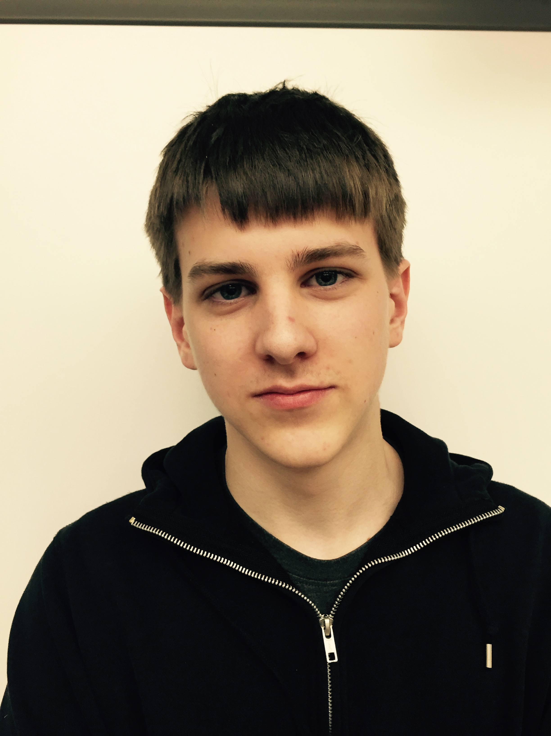
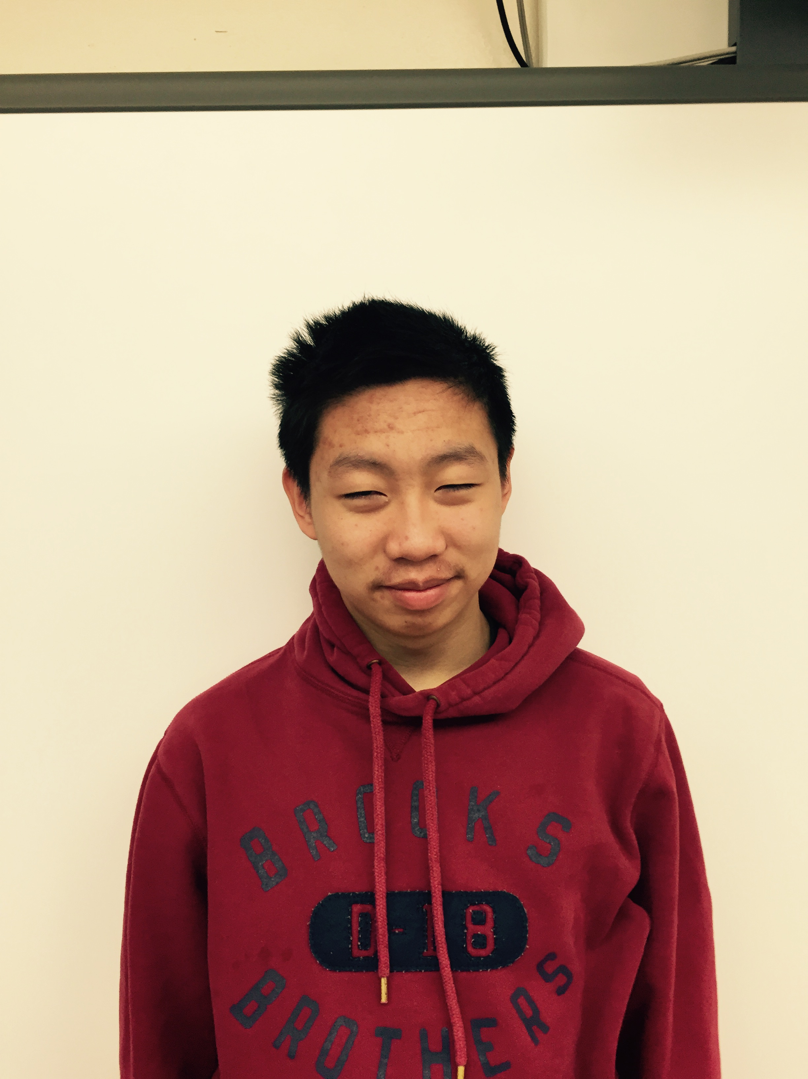
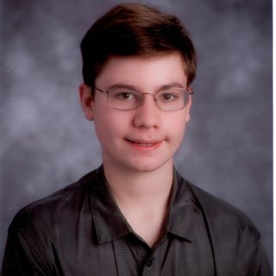
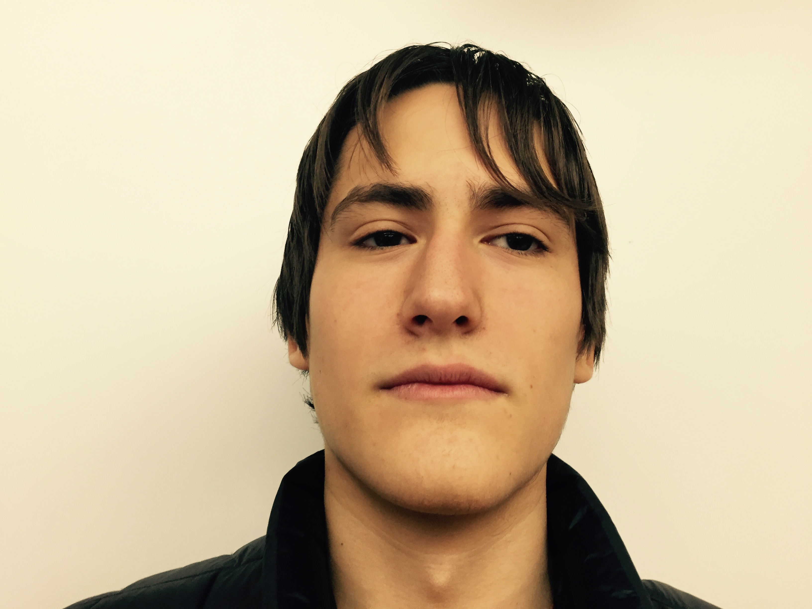
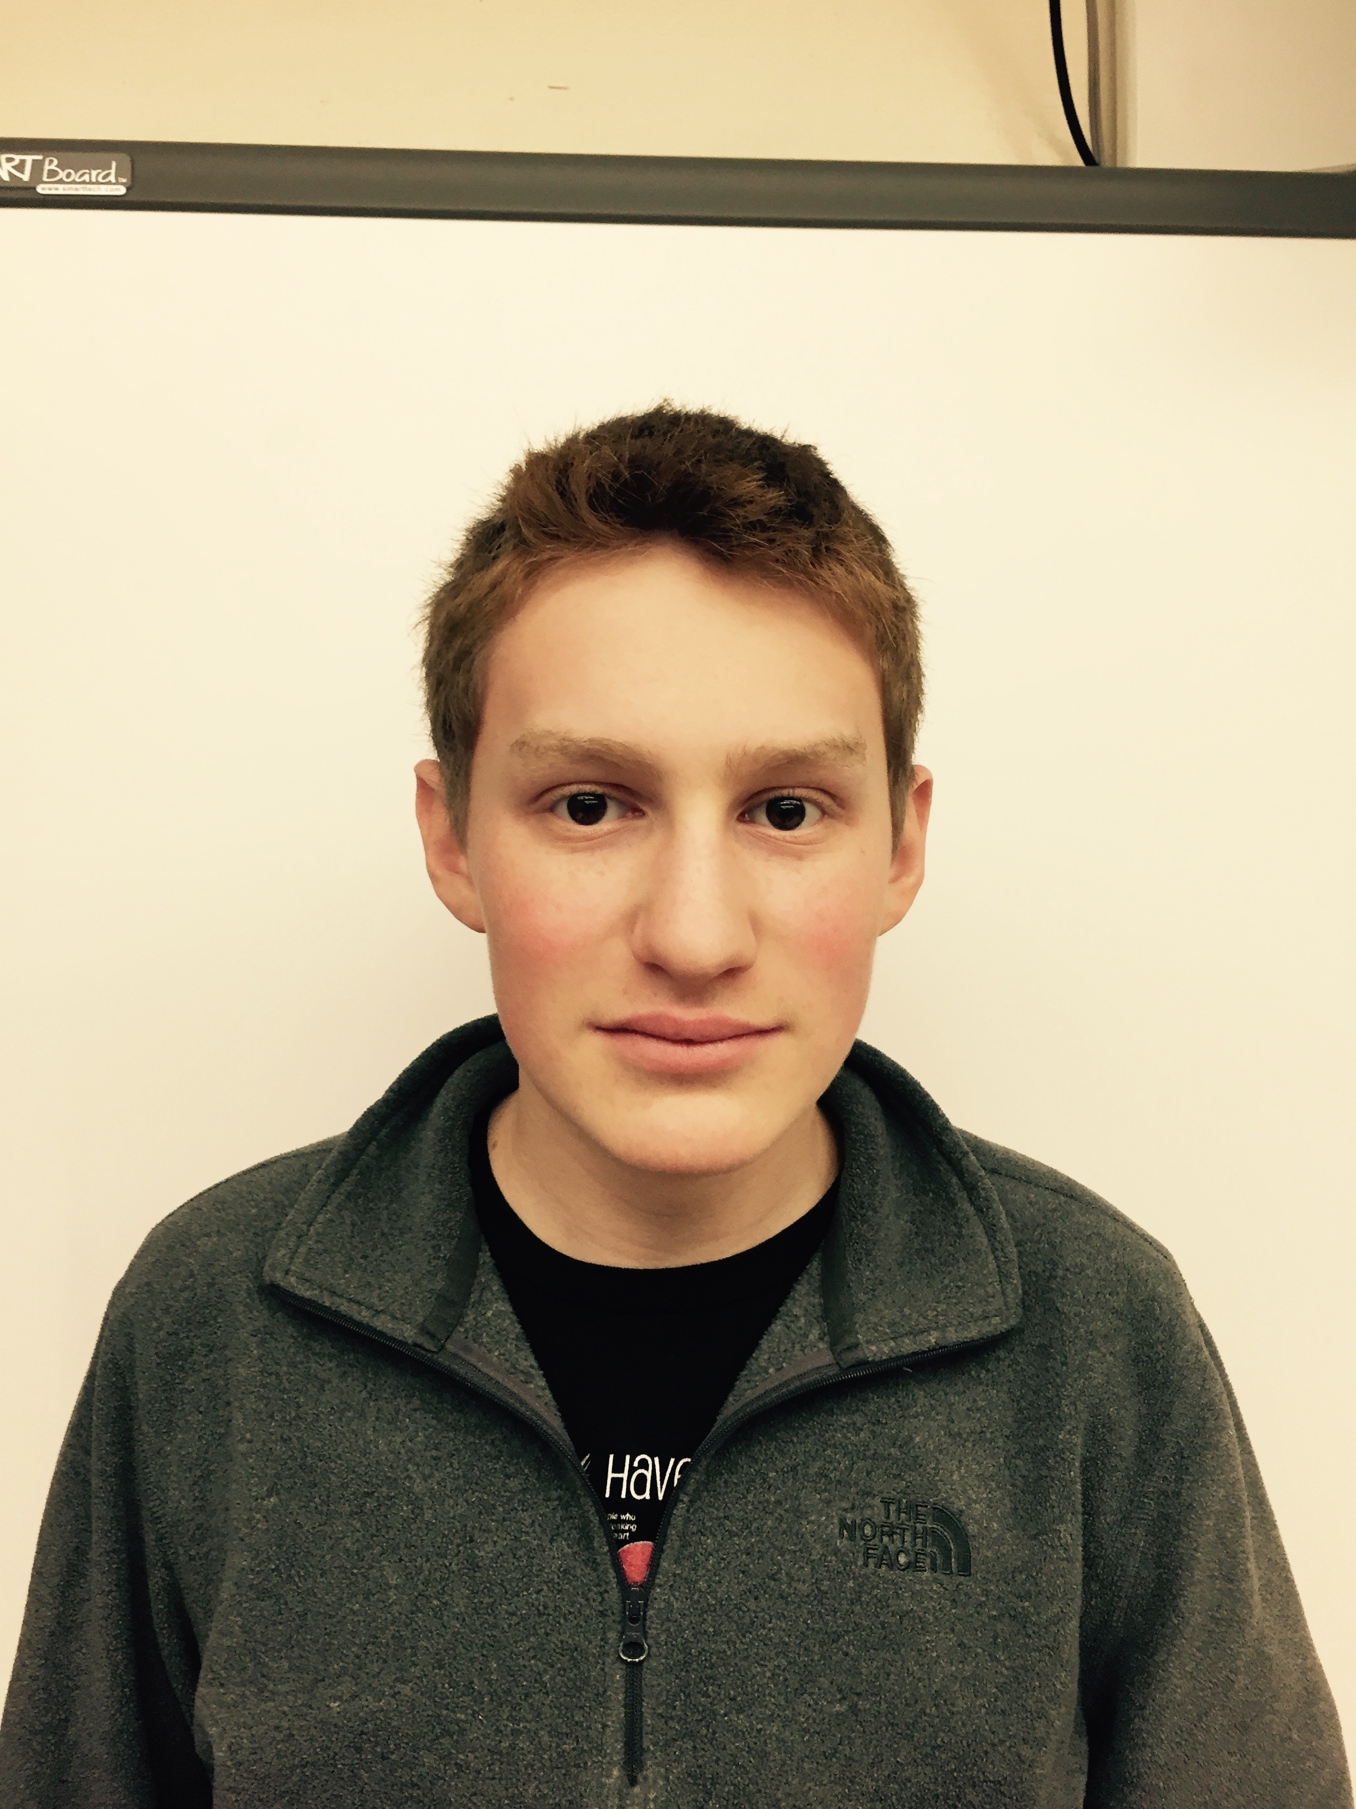
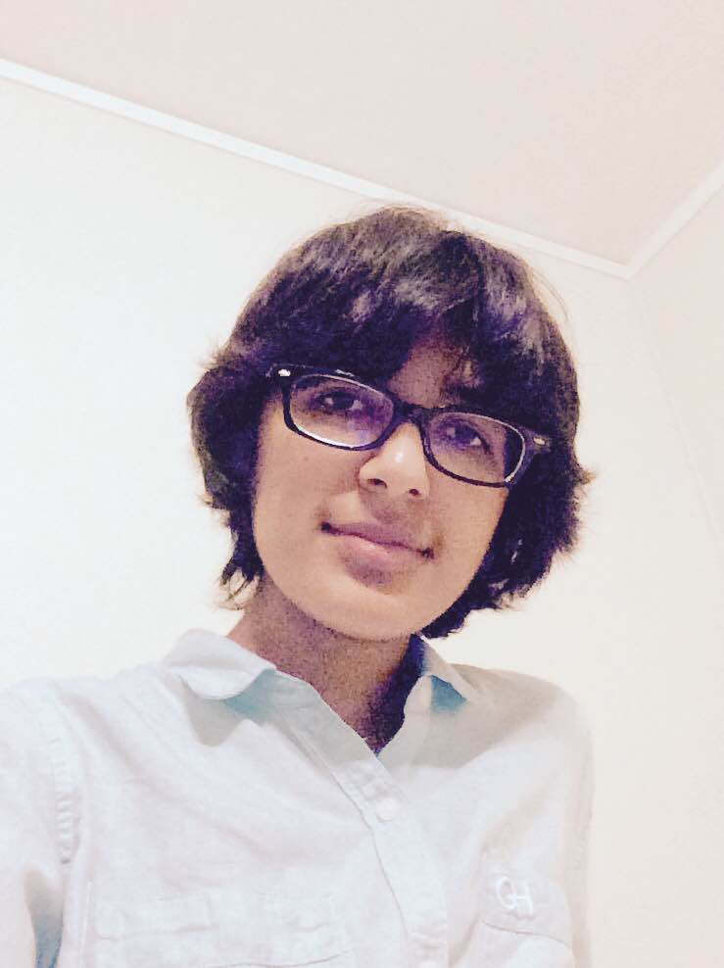
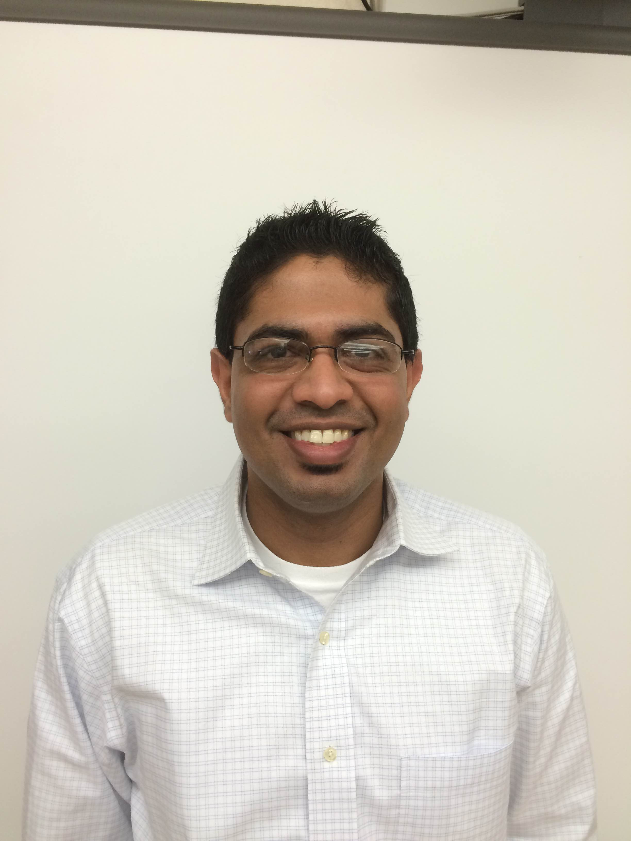
Biographies
Jack Phillips
Project Manager
Mamaroneck High School
jackphillips7764@gmail.com
Yi Zhao
Lead Developer
Mamaroneck High School
awesomeyi@gmail.com
Andrew Katz
Sysadmin & Platform Manager
Mamaroneck High School
aakatz3@gmail.com
Alex Trevithick
Assistant Developer
Mamaroneck High School
atrevith@gmail.com
Cole Berke
Assistant Developer
Mamaroneck High School
cole.berke@gmail.com
Rhea Dedhia
Consultant
Pelham Memorial High School
dedhia.2016@gmail.com
Jigar Jadav
Team Coach
Mamaroneck High School
jjadav@mamkschools.org

Slide 3
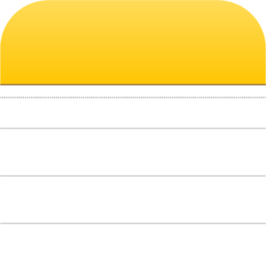

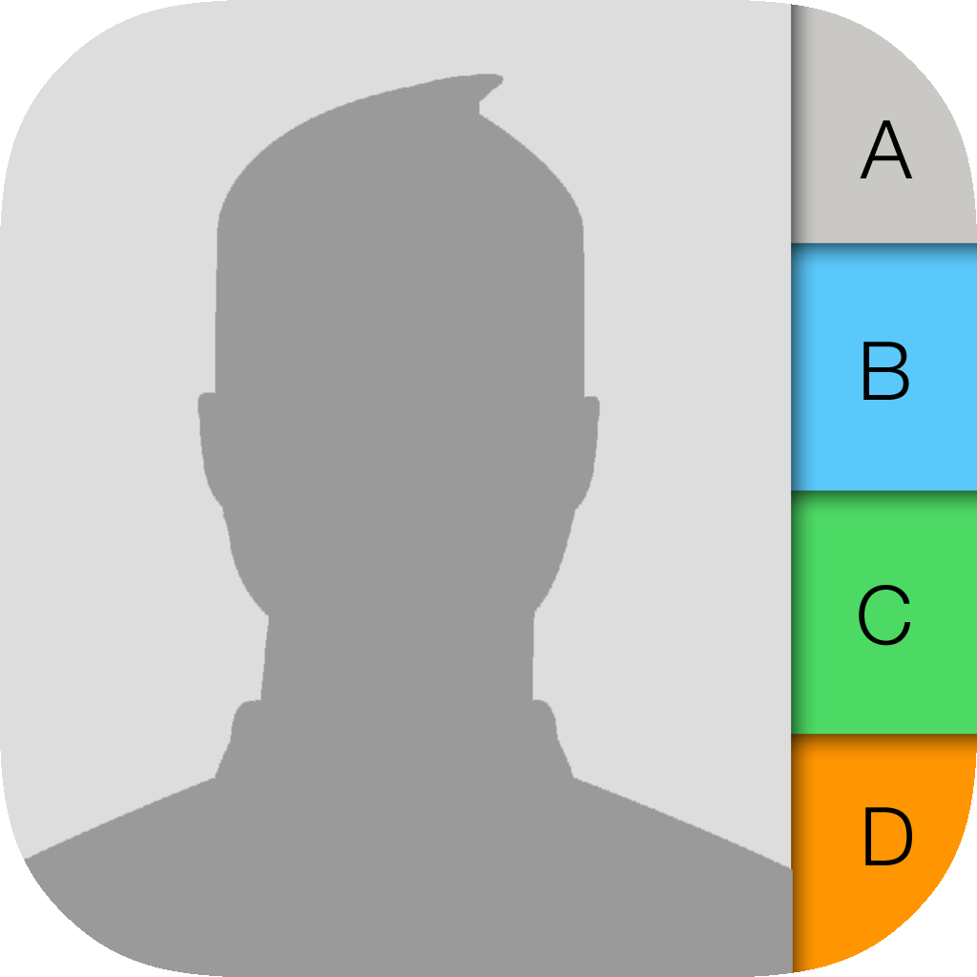



Purpose of app
To help Alzheimer’s patients manage their events and keep track of people who are at the events.
This will help the patients be able to remember names and information about people who are at an event, as well as what events are coming up and happening. It will allow the caregiver to input events and select flashcards for each person.
Similar Apps
Calendar apps, contacts apps, notes apps

Slide 4
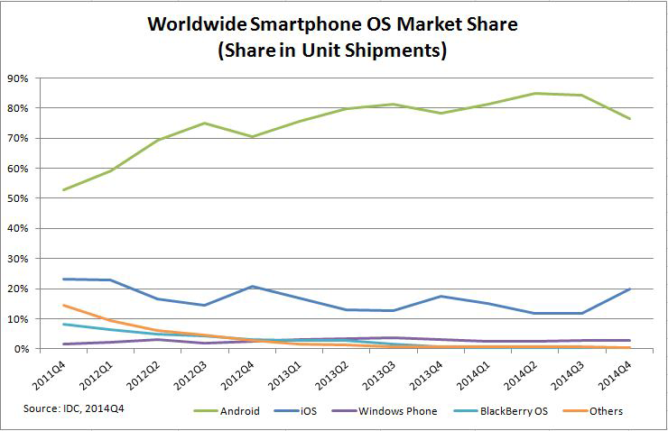
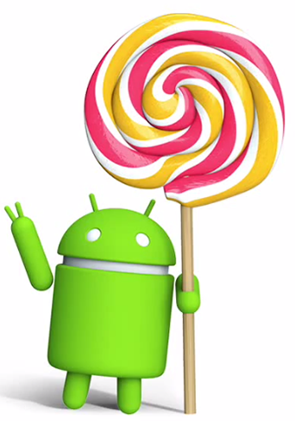
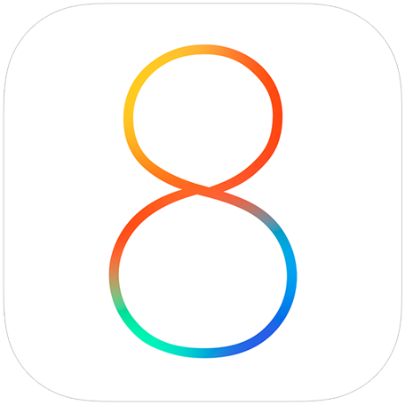

Slide 5
App Communication Model

Slide 6
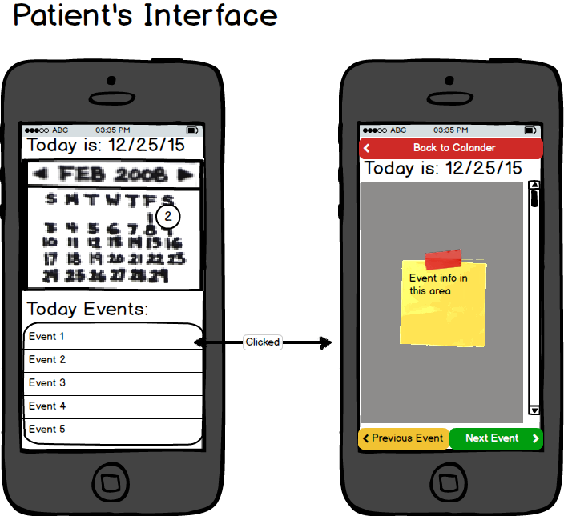
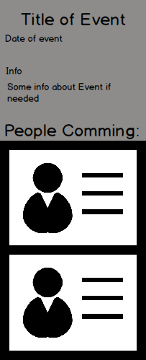
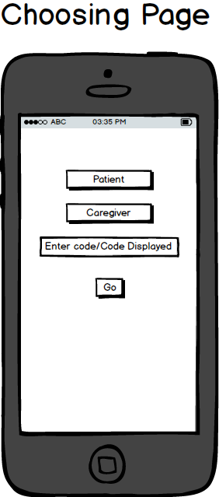
App Mockup

Slide 7
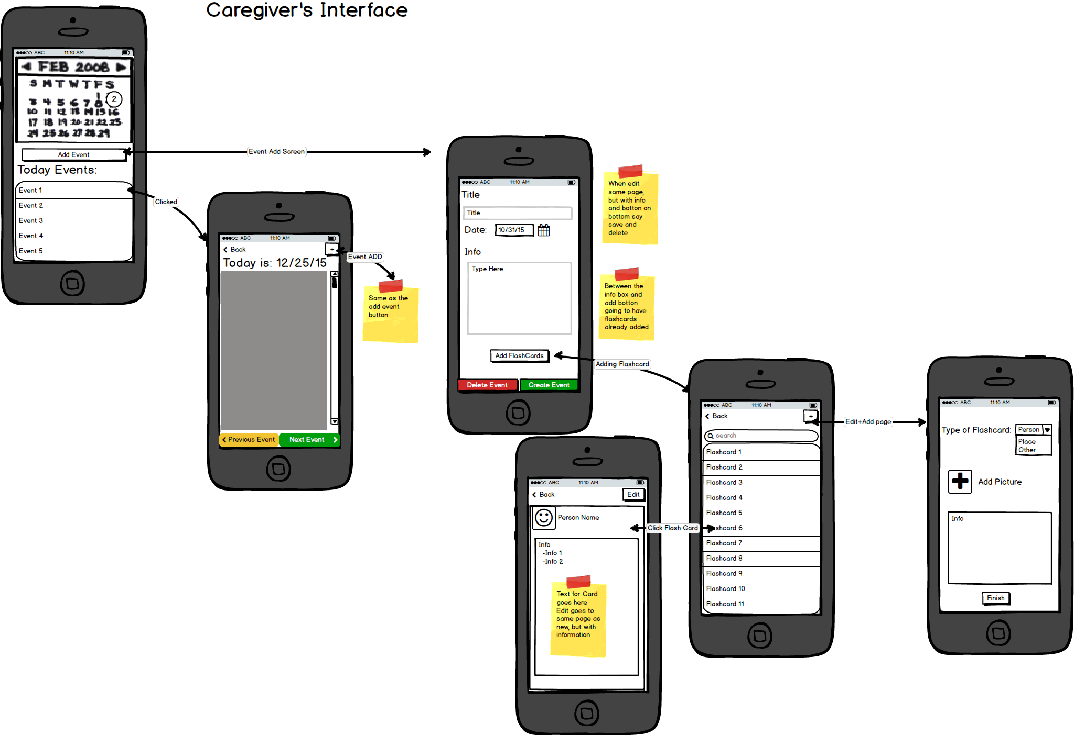
App Mockup (Continued)

Slide 8
Thank you
Are there any questions?

